Slide 1
Chapter 1
Regular Languages

Slide 2
Models of Computation
Computability Theory
Deals with the mathematical basis for Computer Science
Help us answer the question: “What can and cannot be computed”
Computational Model
Mathematical object (defined on paper) that enables us to reason about computation and to study the properties and limitations of computing.
Can we build a simple model of computation?
FINITE AUTOMATA
Good model for computers with an extremely limited amount of memory
Useful tools when attempting to recognize patterns

Slide 3
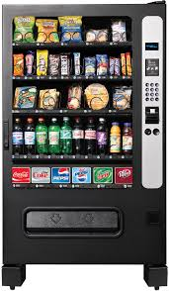
A Snack Machine Example
Assumptions
Every item costs 75 cents
This machine takes
Quarters (q)
Fifty cent coins (f)
One dollar coins (d)
After 75 cents are deposited, the user can push the button “Item” (b) and the machine resets
The machine does not give change for inputs higher than 75 cents
Items never run out

Slide 4
A Snack Machine Example
Input | Output
Quarter
Quarter
Quarter
Button | An item
Quarter
Dollar
Button | An item
Fifty cents
Fifty cents
Button | An item

Slide 5
A Snack Machine Example
The machine understands very few instructions
Depositing a coin
Pushing “Item” button
The state of the machine is the amount of change deposited, since the last time the machine reset
0
0.25
0.50
0.75
Begin
(or start state)
End
(or final state)

Slide 6
A Snack Machine Example
b
0
0.25
0.50
0.75

Slide 7
A Snack Machine Example
b
q
0
0.25
0.50
0.75

Slide 8
A Snack Machine Example
b
q
q
0
0.25
0.50
0.75

Slide 9
A Snack Machine Example
b
q
q
q
0
0.25
0.50
0.75

Slide 10
A Snack Machine Example
b
q
q
q
q
0
0.25
0.50
0.75
b

Slide 11
A Snack Machine Example
q
b
q
q
q
0
0.25
0.50
0.75
f
b

Slide 12
A Snack Machine Example
q
b
q
q
q
0
0.25
0.50
0.75
f
f
b

Slide 13
A Snack Machine Example
b
q, f
q
q
q
0
0.25
0.50
0.75
f
f
b

Slide 14
A Snack Machine Example
b
d
q, f
q
q
q
0
0.25
0.50
0.75
f
f
b

Slide 15
A Snack Machine Example
d
q, f, d
b
q
q
q
0
0.25
0.50
0.75
f
f
b

Slide 16
A Snack Machine Example
f, d
b
d
q, f, d
q
q
q
0
0.25
0.50
0.75
f
f
b

Slide 17
A Snack Machine Example
f, d
b
d
q, f, d
q
q
q
0
0.25
0.50
0.75
f
f, d
b

Slide 18
A Snack Machine Example
f, d
b
d
q, f, d
q
q
q
0
0.25
0.50
b
0.75
b
f
f, d
b

Slide 19
Finite Automaton
Informally
FA = state transition diagram + a start state + some final states
f, d
b
d
q, f, d
q
q
q
0
0.25
0.50
b
0.75
A final state
b
A start state
f
f, d
b
A transition

Slide 20
Finite Automaton
Informally
FA = state transition diagram + a start state + some final states
More “input” alternatives
f, d
d
b
d
q, f, d
b
d
q, f, d
q
q
q
q
q
q
, f
0
0.25
0.50
b
0.75
0
0.25
b
0.50
0.75
b
b
f
f
f, d
b
f, d
b
A new “reset” option
b
A new final state
A 0.75-item machine
A 0.5-item and 0.75-item machine

Slide 21
So Far…
Finite Automaton
Is a …. model for computers with an extremely limited amount of memory
Good for … emulating simple/few instructions
Useful when … attempting to recognize patterns
Consists of
States
Transitions
A single start state
One or more final states
Alphabet

Slide 22
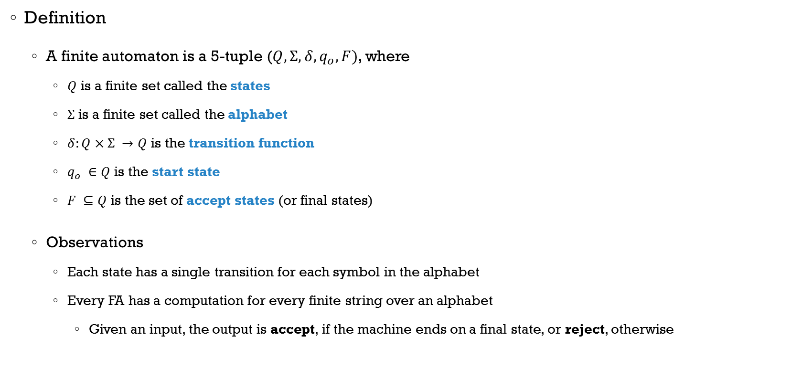
Finite Automaton
Definition
A finite automaton is a 5-tuple ($Q, Σ, δ, q_{o}, F)$, where
$Q$ is a finite set called the states
$Σ$ is a finite set called the alphabet
$δ:Q×Σ →Q$ is the transition function
$q_{o} ∈Q$ is the start state
$F ⊆Q$ is the set of accept states (or final states)
Observations
Each state has a single transition for each symbol in the alphabet
Every FA has a computation for every finite string over an alphabet
Given an input, the output is accept, if the machine ends on a final state, or reject, otherwise

Slide 23
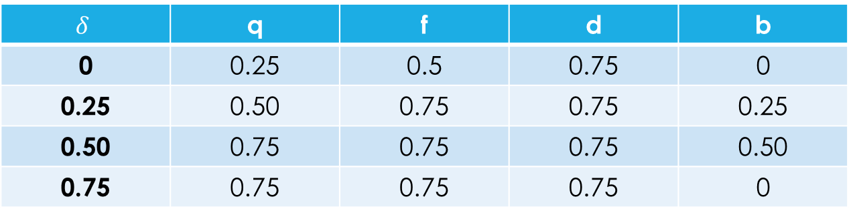
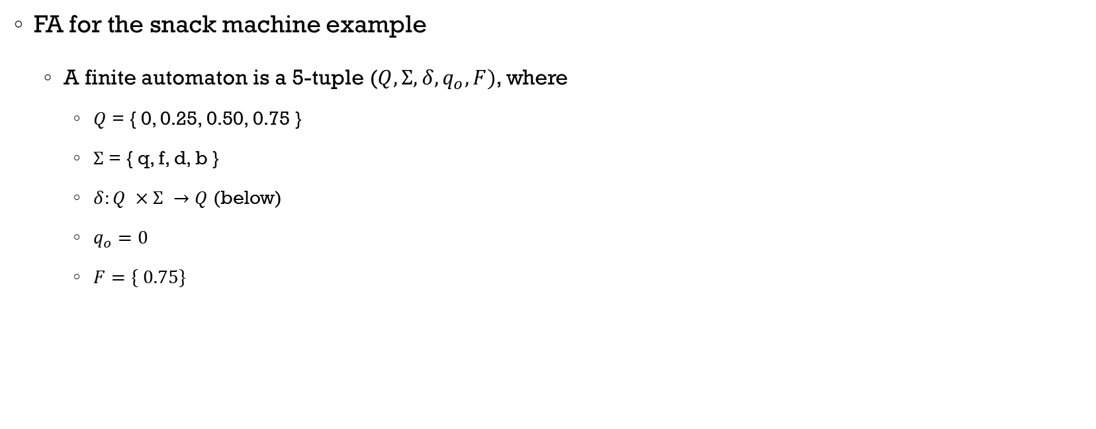
Finite Automaton
f, d
b
d
q, f, d
FA for the snack machine example
A finite automaton is a 5-tuple ($Q, Σ, δ, q_{o}, F)$, where
$Q$ = { 0, 0.25, 0.50, 0.75 }
$Σ$ = { q, f, d, b }
$δ:Q ×Σ →Q$ (below)
$q_{o}=0$
$F=\{ 0.75\}$
q
q
q
0
0.25
0.50
b
0.75
b
f
f, d
b
Alphabet symbols
$$δ$$ | q | f | d | b
0 | 0.25 | 0.5 | 0.75 | 0
0.25 | 0.50 | 0.75 | 0.75 | 0.25
0.50 | 0.75 | 0.75 | 0.75 | 0.50
0.75 | 0.75 | 0.75 | 0.75 | 0
States

Slide 24
The Language of a FA
The language recognized (or accepted) by a FA M contains all the input strings which can take M from the start to the final state
For M and an input string x, if M stops in a ﬁnal state after reading string x then M accepts x, or x is a member of the language recognized by M, i.e., x ∈ L(M)
If A is the set of all the strings a machine M accepts, the A is the language of the machine M, i.e., L(M) = A
Observations
A machine may accept several strings, but recognizes only one language
If the machine accepts no strings, it still recognizes one language, i.e., the empty language
Remember that there is a difference between the empty language and a language the accepts only the empty string

Slide 25
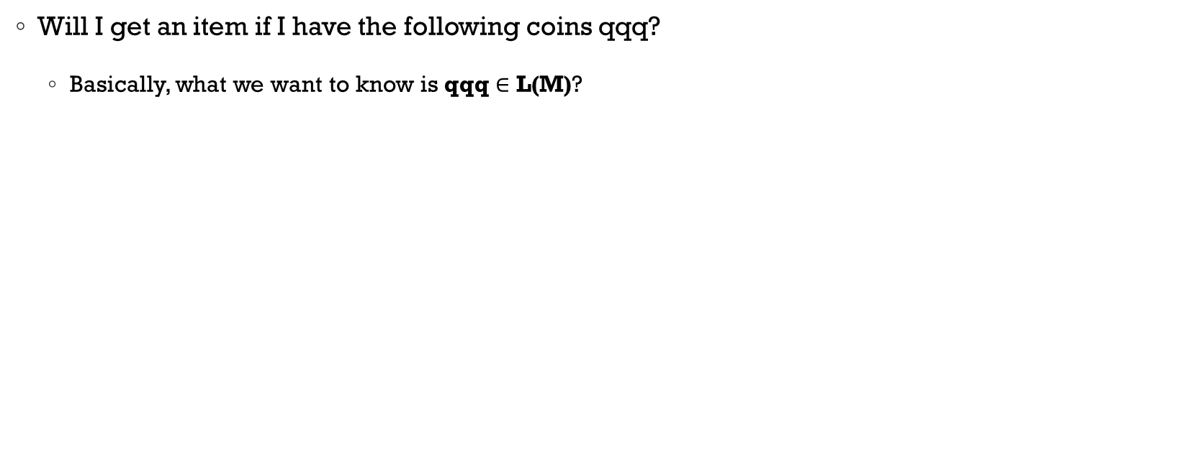
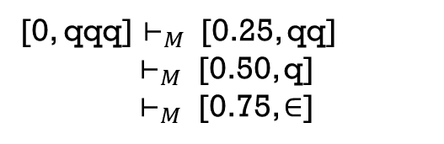
L(M) of the Snack Machine
Will I get an item if I have the following coins qqq?
Basically, what we want to know is qqq $∈$ L(M)?
f, d
[0, qqq] $⊢_{M }$ [0.25, qq]
$⊢_{M }$ [0.50, q]
$⊢_{M }$ [0.75, $∈$]
f, d
d
q, f, d
q
q
q
0
0.25
0.50
0.75
Final state
Done with string
f
Accept!
Notes:
Simplified machines

Slide 26
L(M) of the Snack Machine
Input
String
(Tape)
q
q
q
q
q
q
q
q
q
q
q
q
Next input symbol
0
0
0
0
0.75
0.25
0.75
0.25
0.75
0.25
0.75
0.25
Current state
0.50
0.50
0.50
0.50
M
M
M
M
Finite Automaton
Done on final state. Accept!

Slide 27

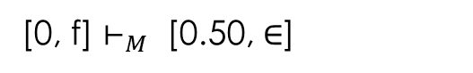
L(M) of the Snack Machine
Will I get an item if I have the following coin f?
Basically, what we want to know is f $∈$ L(M)?
f, d
f, d
[0, f] $⊢_{M }$ [0.50, $∈$]
d
q, f, d
q
q
q
Done with string
0
0.25
0.50
0.75
Not a final state
f
Reject!
Notes:
Simplified machines – Basically, the string “f” is not a member of L(M)

Slide 28
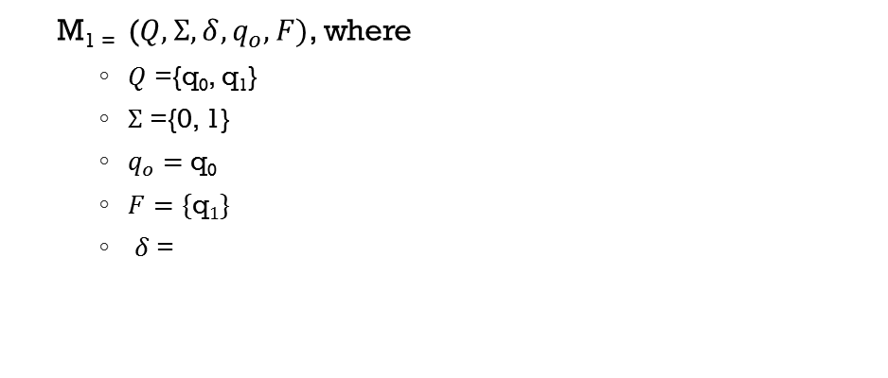
Example 1 – Finite Automaton
Consider the state diagram of finite automaton M₁
What is the formal description of M₁ ?
What is the language recognized by M₁ ?
0
1
1
q₀
q₁
0
M₁ ₌ ($Q, Σ, δ, q_{o}, F)$, where
$Q$ ={q₀, q₁}
$Σ$ ={0, 1}
$q_{o}=$ q₀
$F=\{\text{q}1\}$
$δ$ =
Accepted strings
01011
1
01101
L(M₁) = {w|w ends with a 1}
 | 0 | 1
q₀ | q₀ | q₁
q₁ | q₀ | q₁

Slide 29

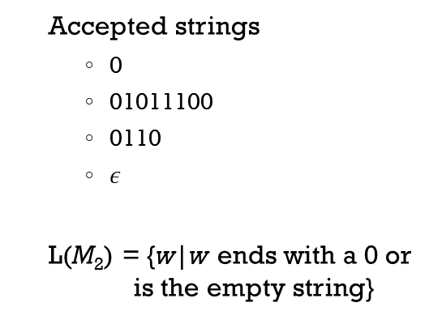
Example 2 - Finite Automaton
Consider the state diagram of finite automaton M₂
What is the formal description of M₂ ?
What is the language recognized by M₂ ?
1
0
0
q₁
q₀
1
M₂ ₌ ($Q, Σ, δ, q_{o}, F)$, where
$Q$ ={q₀, q₁}
$Σ$ ={0, 1}
$q_{o}=$ q₀
$F=\{\text{q}\text{0}\}$
$δ$ =
Accepted strings
0
01011100
0110
$ε$
L(M₂) = {w|w ends with a 0 or is the empty string}
 | 0 | 1
q₀ | q₀ | q₁
q₁ | q₀ | q₁

Slide 30

Complementing Languages
By swapping final states and non-final states of M₁, we get a new finite automaton M₂, such that L(M₂)= $\overline{\text{L}\text{(}\text{M}\text{1}\text{)}}$, i.e., the complement of L(M₁)
0
1
0
1
1
1
q₀
q₁
q₀
q₁
0
0
M₁
M₂

Slide 31
More Finite (State) Automata
0, 1
(a)
0
1
0
1
1
1
1
q₁
(c)
q₀
q₁
q₂
>
q₀
q₂
0
a
b
(d)
“The set of all strings ending in 00”.
(b)
q₁
b
a
q₃
a
(e)
“The set of all strings when interpreted
as a binary integer, is a multiple of 5,
e.g., strings 101, 1010, and 1111 are in
the language, whereas 10, 100, and 111
are not”.
>
q₀
q₂
a
b
q₄
b
b
a

Slide 32
Regular Languages
Remember that a language is a set of strings over some alphabet
A finite automata M recognizes a language A if A = { w| M accepts w }
Definition
A language is called a regular language if some finite automaton recognizes it

Slide 33
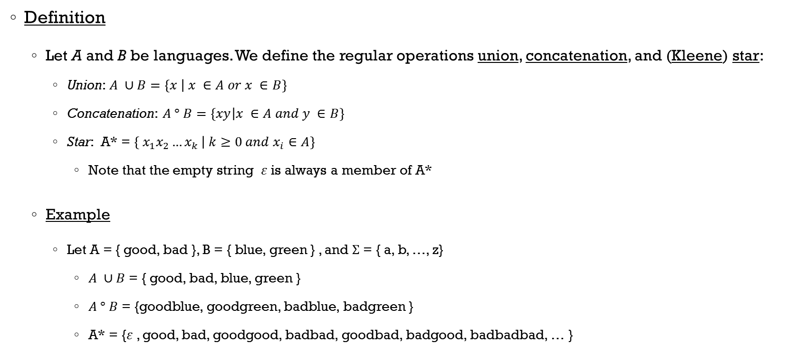
Regular Operations
Definition
Let A and B be languages. We define the regular operations union, concatenation, and (Kleene) star:
Union: $A ∪B=\left\{x | x ∈A or x ∈B\right\}$
Concatenation: $A ° B=\left\{xy | x ∈A and y ∈B\right\}$
Star: A* = $\left\{{ x}_{1}x_{2}{…x}_{k} | k≥0 and x_{i}∈A\right\}$
Note that the empty string $ε$is always a member of A*
Example
Let A = { good, bad }, B = { blue, green } , and $Σ$ = { a, b, …, z}
$A ∪B$ = { good, bad, blue, green }
$A ° B$ = {goodblue, goodgreen, badblue, badgreen }
A* = {$ε$, good, bad, goodgood, badbad, goodbad, badgood, badbadbad, … }
Binary operations
Unary operations

Slide 34
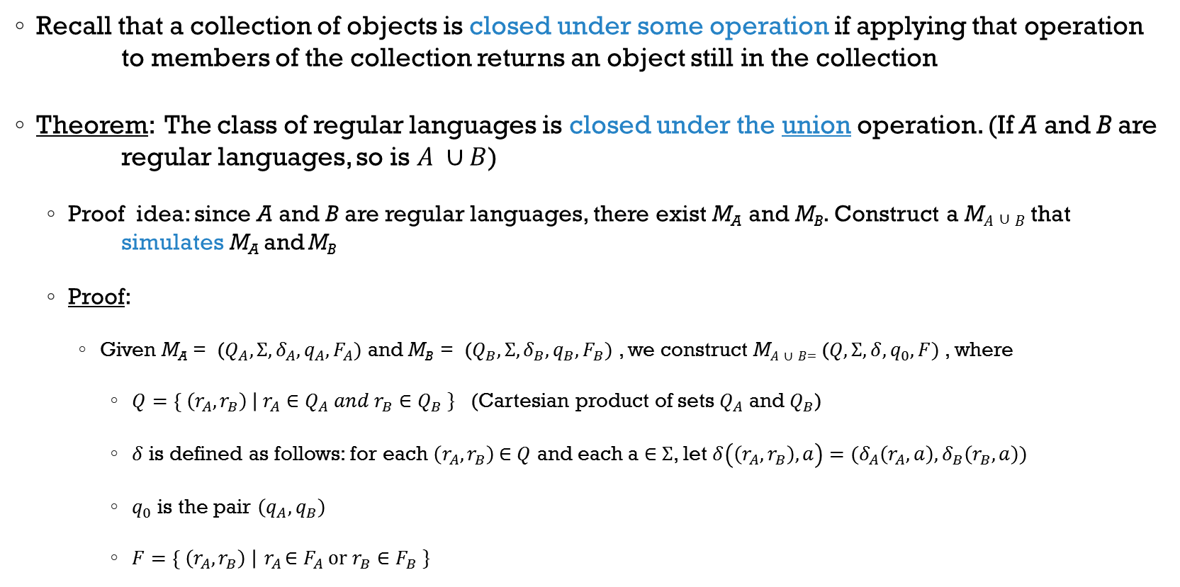
Closed Operations
Recall that a collection of objects is closed under some operation if applying that operation to members of the collection returns an object still in the collection
Theorem: The class of regular languages is closed under the union operation. (If A and B are regular languages, so is $A ∪B$)
Proof idea: since A and B are regular languages, there exist M_{A} and M_{B}. Construct a M$A∪B$ that simulates M_{A} and M_{B}
Proof:
Given M_{A} = ($Q_{A}, Σ, δ_{A}, q_{A}, F_{A})$ and M_{B} = ($Q_{B}, Σ,δ_{B}, q_{B}, F_{B})$ , we construct M$A∪B$₌ ($Q, Σ, δ, q_{0}, F_{ })$ , where
$Q=\left\{ \left(r_{A}, r_{B}\right) \right| r_{A}∈Q_{A} and{ r}_{B}∈Q_{B} \}$ (Cartesian product of sets $Q_{A}$ and $Q_{B}$)
$δ$ is defined as follows: for each $\left(r_{A}, r_{B}\right)$ $∈$ $Q$ and each a $∈$ $Σ$, let $δ\left(\left(r_{A}, r_{B}\right), a\right)=(δ_{A}\left(r_{A}, a\right),δ_{B}\left(r_{B}, a\right))$
$q_{0}$ is the pair $\left(q_{A}, q_{B}\right)$
$F=\left\{ \left(r_{A}, r_{B}\right) \right|{ r}_{A}∈F_{A} or{ r}_{B}∈F_{B} \}$

Slide 35
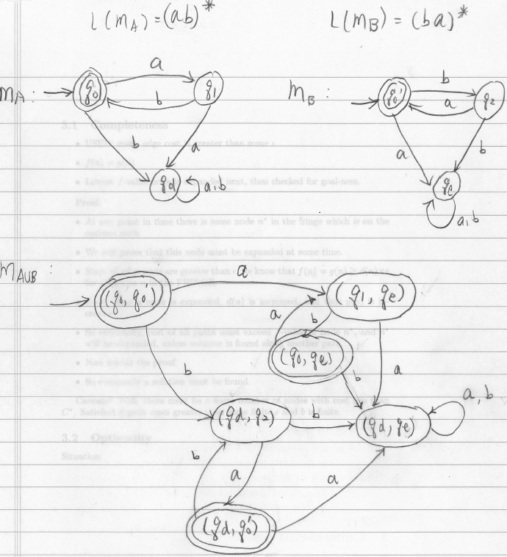
Example of the Closed Operation Union

Slide 36
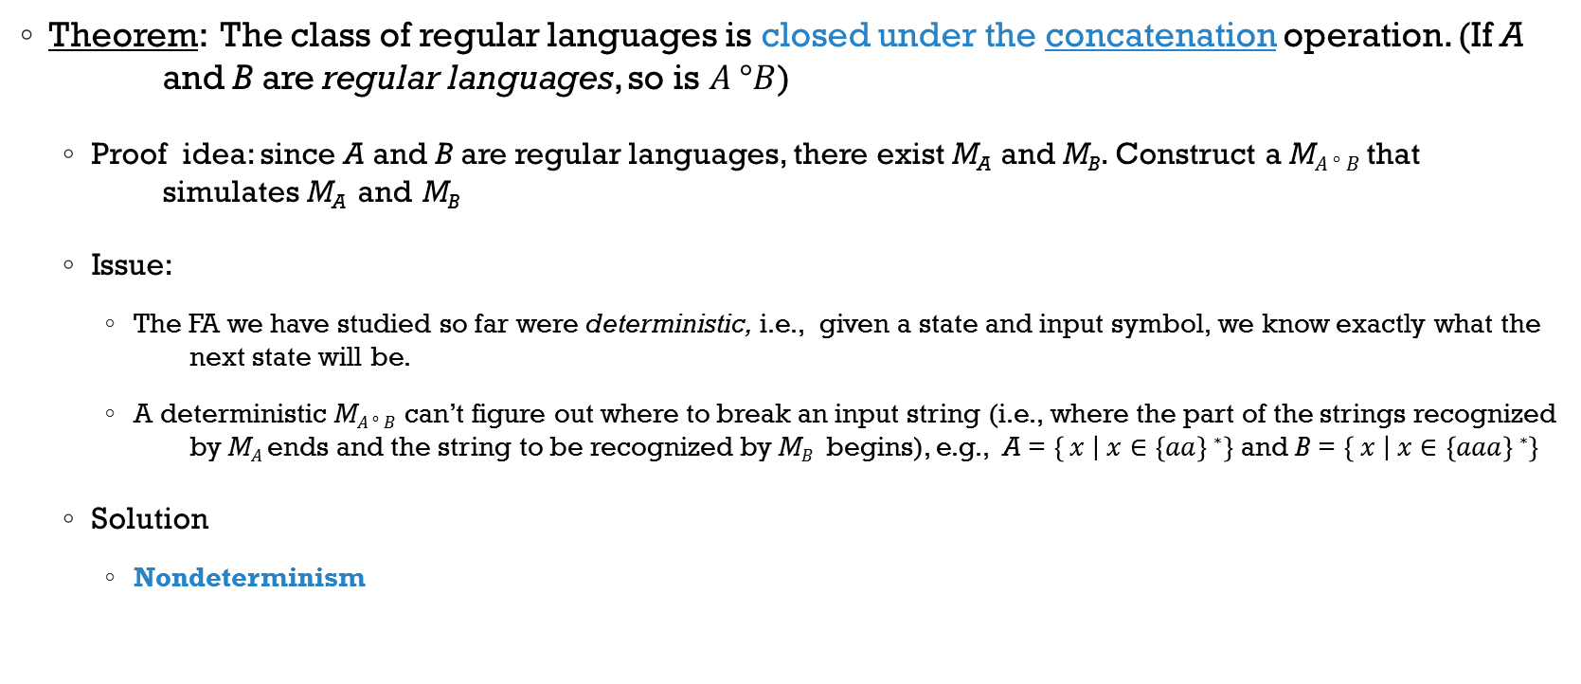
Closed Operations
Theorem: The class of regular languages is closed under the concatenation operation. (If A and B are regular languages, so is $A °B$)
Proof idea: since A and B are regular languages, there exist M_{A} and M_{B}. Construct a M$A ° B$ that simulates M_{A} and M_{B}
Issue:
The FA we have studied so far were deterministic, i.e., given a state and input symbol, we know exactly what the next state will be.
A deterministic M$A ° B$ can’t figure out where to break an input string (i.e., where the part of the strings recognized by M$A$ends and the string to be recognized by M$B$ begins), e.g., A = $\left\{ x | x∈\left\{aa\right\}∗\right\}$ and B = $\left\{ x | x∈\left\{aaa\right\}∗\right\}$
Solution
Nondeterminism

Slide 37
So Far…
Definition
Operations
FA
Regular Languages
Closure
State diagram
Tracing of strings
Recognize/Accept Languages
Limitations of deterministic FA

Slide 38
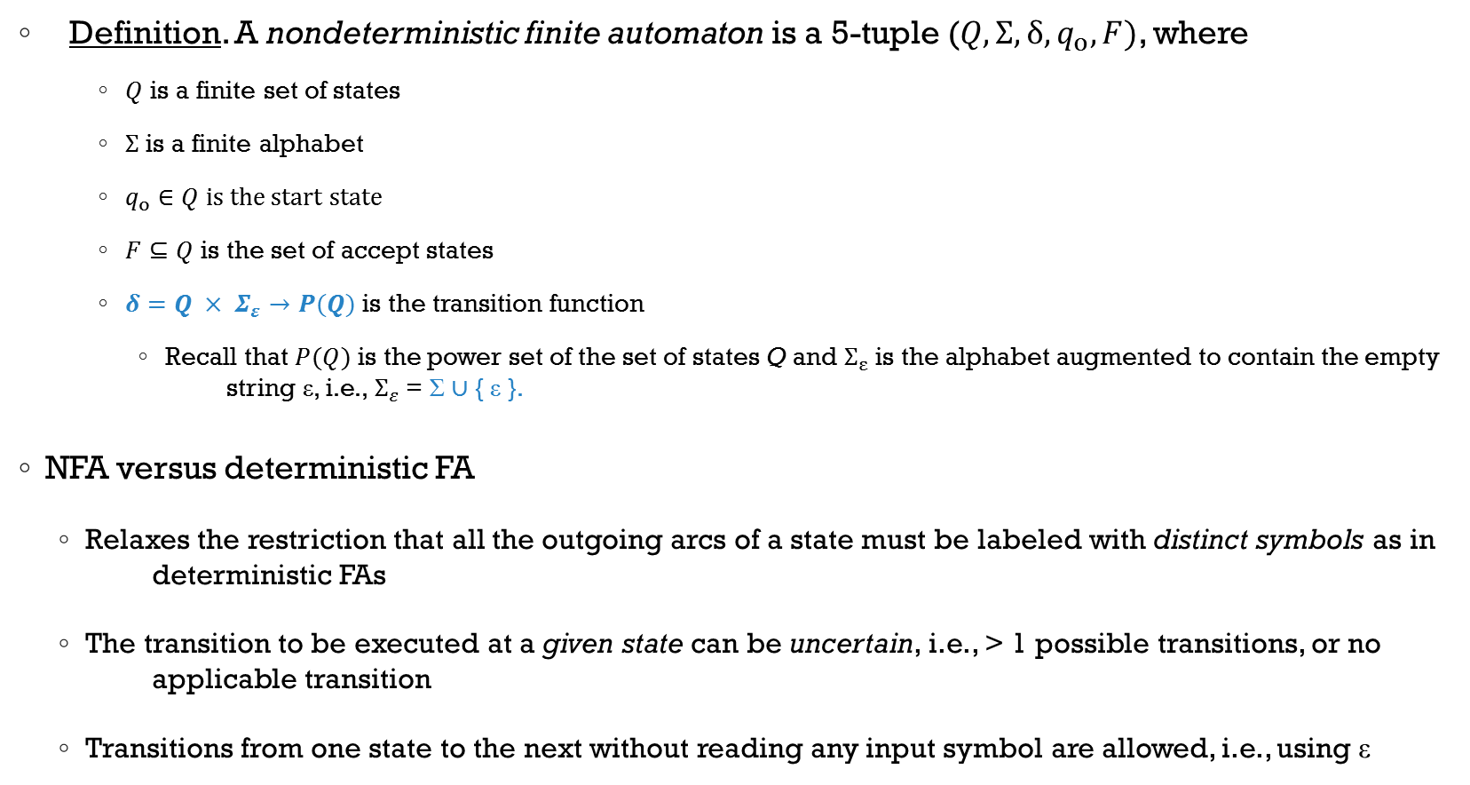
Nondeterministic FA (NFA)
Definition. A nondeterministic finite automaton is a 5-tuple ($Q, Σ, δ, q_{o}, F)$, where
$Q$ is a finite set of states
$Σ$ is a finite alphabet
$q_{o}∈Q$ is the start state
$F⊆Q$ is the set of accept states
$δ=Q × Σ_{ε}→P(Q)$ is the transition function
Recall that $P(Q)$ is the power set of the set of states Q and $Σ_{ε}$ is the alphabet augmented to contain the empty string ε, i.e., $Σ_{ε}$ = Σ ∪ { ε }.
NFA versus deterministic FA
Relaxes the restriction that all the outgoing arcs of a state must be labeled with distinct symbols as in deterministic FAs
The transition to be executed at a given state can be uncertain, i.e., > 1 possible transitions, or no applicable transition
Transitions from one state to the next without reading any input symbol are allowed, i.e., using ε
Notes:
Applicable for applications that require backtracking technique

Slide 39
Nondeterministic FA (NFA)
Nondeterminism is a generalization of determinism, so every deterministic FA is a NFA, and vice versa
Deterministic versus nondeterministic computations
Deterministic Computation
Non-deterministic Computation
start
accept or reject
reject
accept

Slide 40
NFA - Example 1
Consider the following state diagram of NFA M₁:
M₁ recognizes strings with a “1” in the third position from the end
M₁ stays in the start state until it “guesses” that it is three places from the end of the computation
0,1
q₀
1
q₁
0,1
q₂
0,1
q₃
>
Notes:
Show step-by-step computation of a given string on this NFA

Slide 41
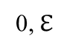
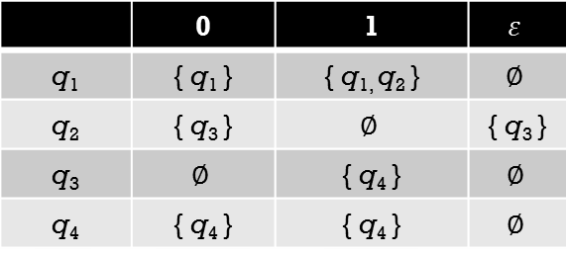
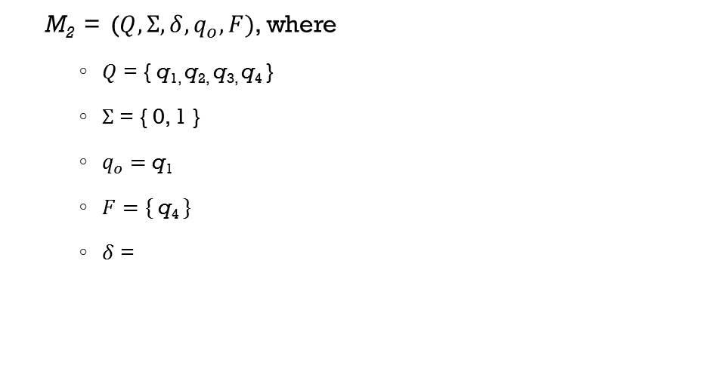
NFA – Example 2
Example
Consider the state diagram (on the right) of NFA M₂
What is the formal definition of M₂?
Which language is recognized by M₂?
0,1
0,1
q₁
1
q₂
0,$ℇ$
q₃
1
q₄
>
M₂ = ($Q, Σ, δ, q_{o}, F)$, where
$Q$ = { q_{1,} q_{2,} q_{3,} q₄ }
$Σ$ = { 0, 1 }
$q_{o}=$ q₁
$F=\{ \text{q}\text{4} \}$
$δ$ =
Accepted strings
01011
11
01101
L(M₂) = {w | w contains substring 101 or 11}
 | 0 | 1 | $$ε$$
q₁ | { q₁ } | { q_{1,} q₂ } | $$∅$$
q₂ | { q₃ } | $$∅$$ | { q₃ }
q₃ | $$∅$$ | { q₄ } | $$∅$$
q₄ | { q₄ } | { q₄ } | $$∅$$

Slide 42
Why NFAs?
Advantages of NFAs over DFAs
Sometimes DFAs have many more states, conceptually more complicated
Understanding the functioning of the NFAs is much easier
Example 1: M₁ and M₂ accept strings over { a, b } if they contain the substring “bb”
Example 2: M accepts strings over {a, b} if they contain either the substring “aa” or “bb”
a
a, b
a, b
a, b
M₁:
M₂:
>
q₀
b
q₁
b
q₂
b
b
>
q₀
q₁
q₂
a
a, b
a
a
q₁
q₂
a, b
>
q₀
b
b
q₃
q₄
a, b
Notes:
Show step-by-step computation of a given string on this NFA == Elena’s Chapter 1.4 -> Examples of NFA String Processing

Slide 43
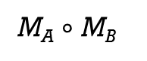
Closure under regular operations
Recall that “The class of regular languages is closed under the union (concatenation and star) operation”
Easier to proof using NFA
Let A and B be two regular languages
M_{A}
M_{B}
ε
ε
ε
ε
ε
M_{A} ∪ M_{B}
M_{A} $∘$ M_{B}
M_{A*}

Slide 44
So Far…
Definition
NFA
Regular Languages
Closure of operations between languages
State diagram
Tracing of strings
“Guessing”

Slide 45
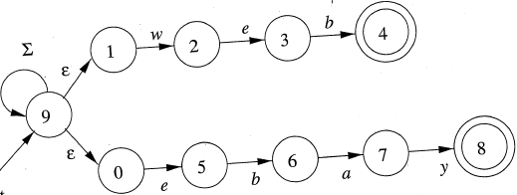
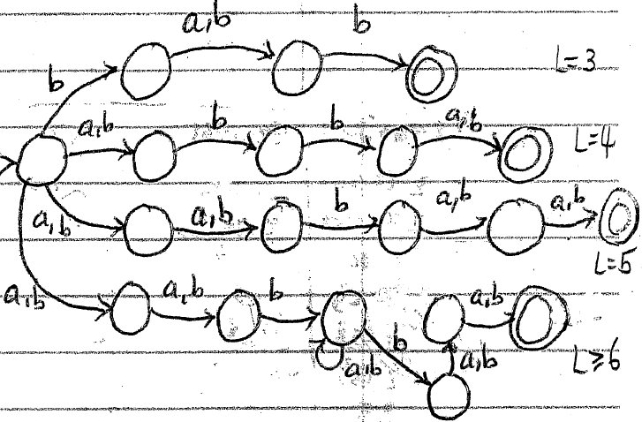
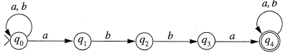
Examples of NFAs
(a)
(c)
(b)
(d)
Give the state diagram of an NFA
that accepts the language (abc)*a*.
(e)
The set of strings of 0’s and 1’s such that there are two 0’s separated by
a number of positions that is a multiple of 4. Note that 0 is an allowable
multiple of 4.

Slide 46
Equivalence of NFAs and DFAs
Two machines are equivalent if they recognize the same language
NFAs and DFAs recognize the same class of languages, i.e., regular languages
Theorem 1.39
Every NFA has en equivalent deterministic FA
Basically, for every NFA N, there exists a DFA M (that simulates N), such that L(N) = L(M)
Proof idea:
We’ll assume that NFA N exists and we’ll construct a DFA that simulates M (that simulates N)
In other words, we’ll show that following certain steps you can convert an NFA into a DFA

Slide 47
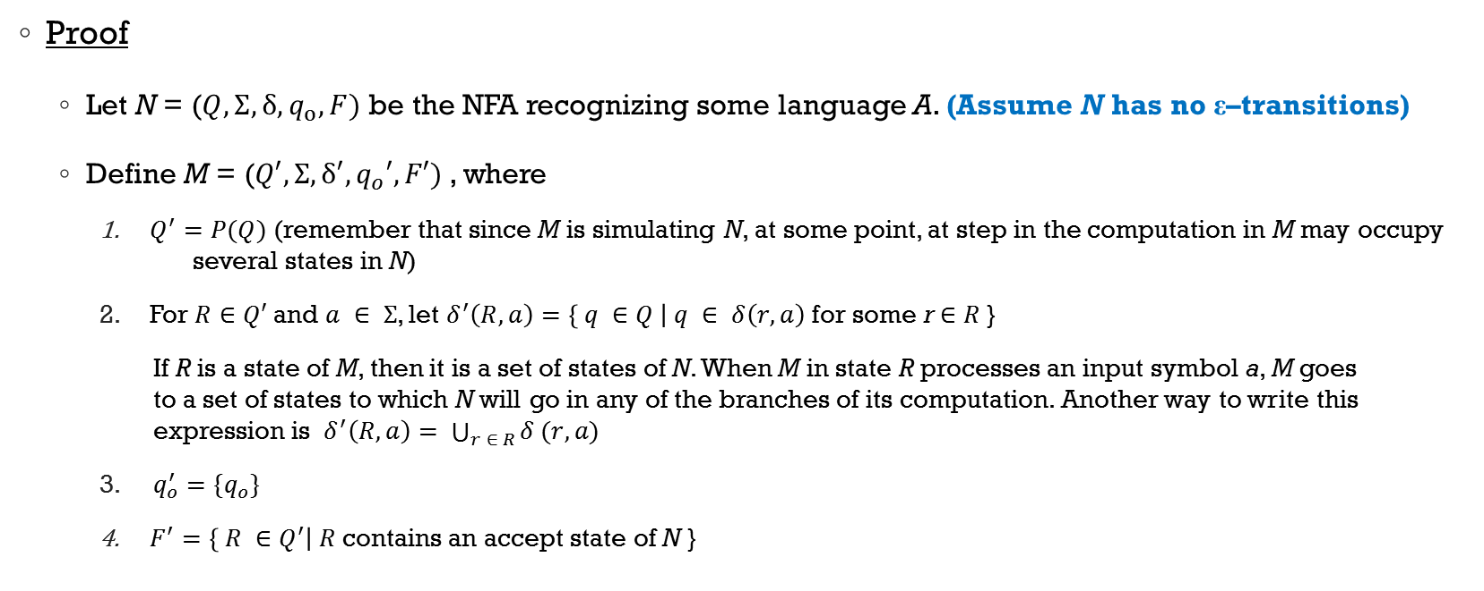
Equivalence of NFAs and DFAs (w/o ε-Transitions)
Proof
Let N = ($Q, Σ, δ, q_{o}, F)$ be the NFA recognizing some language A. (Assume N has no ε–transitions)
Define M = ($Q′, Σ, δ′, q_{o}′, F′)$, where
$Q^{′}=P(Q)$ (remember that since M is simulating N, at some point, at step in the computation in M may occupy several states in N)
For $R∈Q′$ and $a ∈ Σ$, let $δ^{′}\left(R,a\right)=\left\{ q ∈Q \right| q ∈ δ\left(r, a\right)$ for some r $∈$ $R$}
If R is a state of M, then it is a set of states of N. When M in state R processes an input symbol a, M goes to a set of states to which N will go in any of the branches of its computation. Another way to write this expression is $δ^{′}\left(R,a\right)= \bigcup_{r ∈ R}^{ }{δ (r, a)}$
$q_{o}^{′}=\{q_{o}\}$
$F^{′}=\left\{ R ∈Q^{′}\right| R$contains an accept state of N }

Slide 48
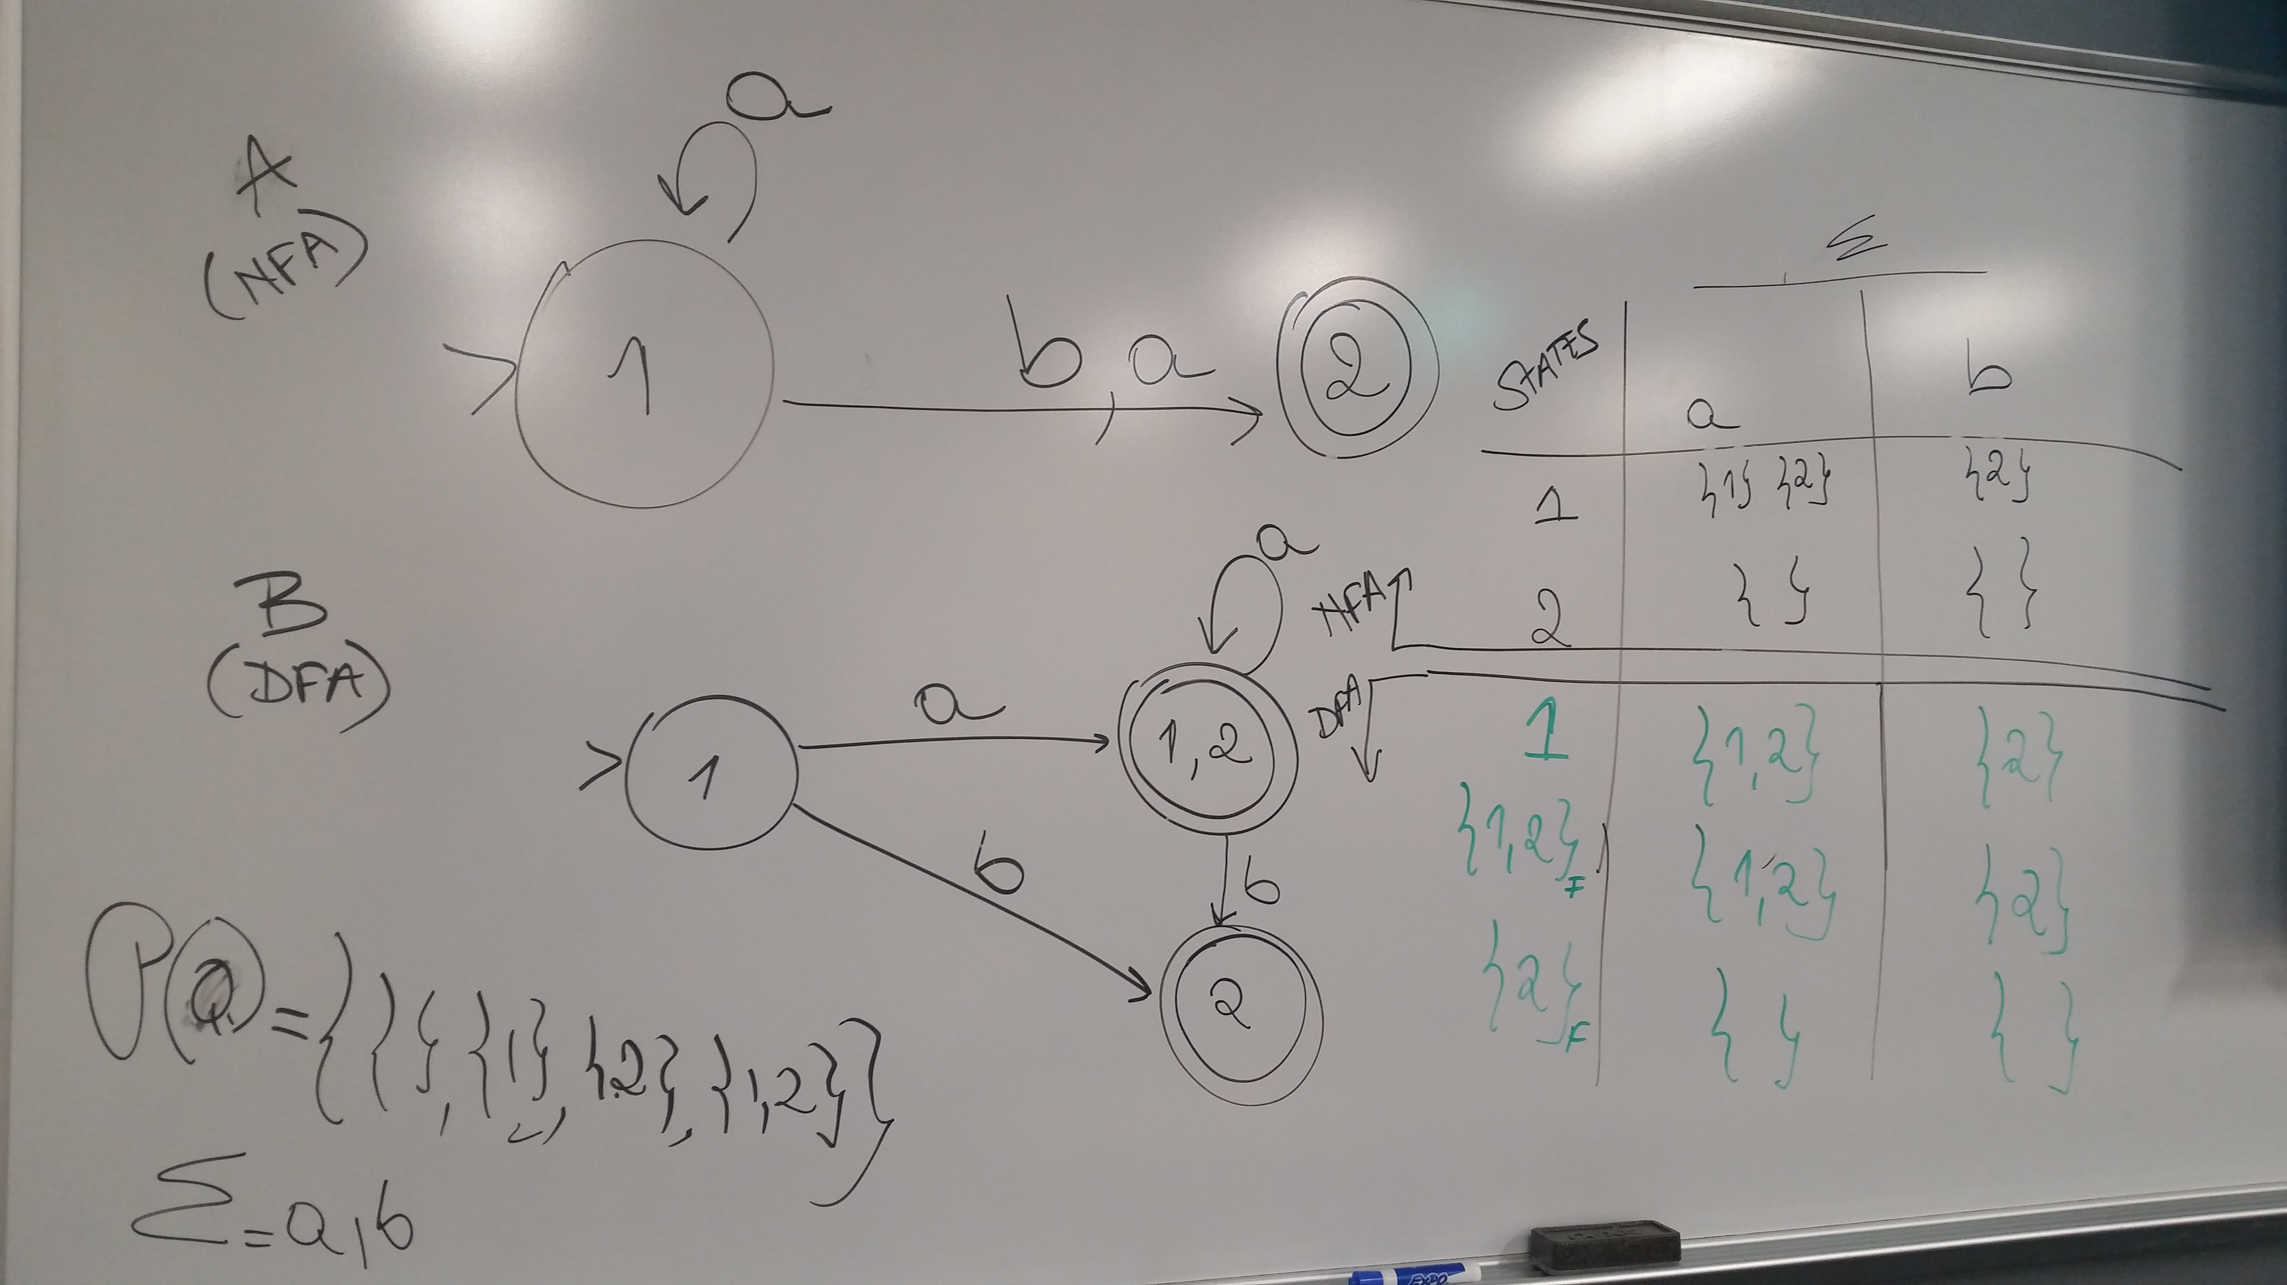
NFA to DFA – A Simple Example

Slide 49
Example 1 - NFA to DFA
Consider the following NFA, which accepts the string “ab”
To simulate this NFA, the DFA must remember the current state of each copy of this NFA after reading an input symbol. Because, in general, NFA may end up in any combination of its state, the set of DFA states is the power set of NFA states.
For the above NFA its DFA equivalent contains the following states ∅, { 0 }, { 1 }, { 2 }, { 0, 1 }, { 0, 2 }, { 1, 2 }, { 0, 1, 2 }
The start state is { 0 } since its where the NFA begins it simulation
The ﬁnal states of DFA are those that contain NFA’s state 2 (the final state of the NFA), i.e., { 2 }, { 0, 2 }, { 1, 2 }, and { 0, 1, 2 }.
a, b
b
b
a
2
0
1
a, b
a

Slide 50
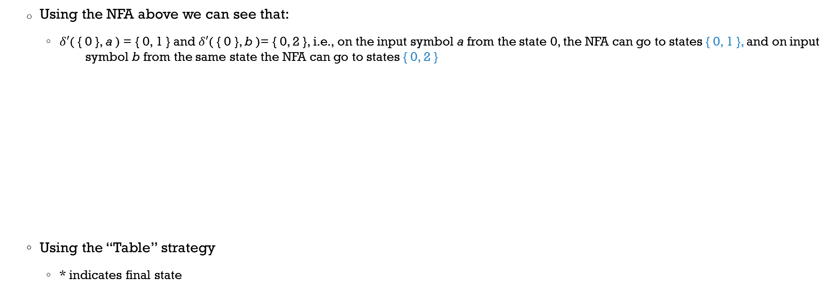
Example 1 - NFA to DFA
a, b
b
b
a
2
0
1
a, b
a
Using the NFA above we can see that:
$δ′$( { 0 }, a ) = { 0, 1 } and $δ′$( { 0 }, b )= { 0, 2 }, i.e., on the input symbol a from the state 0, the NFA can go to states { 0, 1 }, and on input symbol b from the same state the NFA can go to states { 0, 2 }
Using the “Table” strategy
* indicates final state
States | a | b
→ 0 | { 0 , 1 } | { 0, 2 }
1 | { 0 } | { 1 }
2 * | { 0 } | { 0 }
δ (NFA)
→ { 0 }
{ 0, 1 }
{ 0, 2 }
δ’ (DFA)

Slide 51
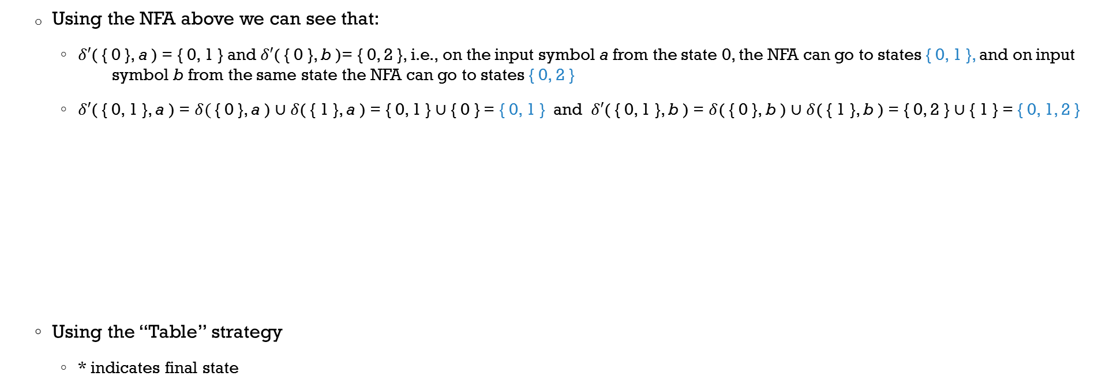
Example 1 - NFA to DFA
a, b
b
b
a
2
0
1
a, b
a
Using the NFA above we can see that:
$δ′$( { 0 }, a ) = { 0, 1 } and $δ′$( { 0 }, b )= { 0, 2 }, i.e., on the input symbol a from the state 0, the NFA can go to states { 0, 1 }, and on input symbol b from the same state the NFA can go to states { 0, 2 }
$δ′$( { 0, 1 }, a ) = $δ(${ 0 }, a ) ∪$δ$( { 1 }, a ) = { 0, 1 } ∪ { 0 } = { 0, 1 } and $δ′$( { 0, 1 }, b ) = $δ$( { 0 }, b ) ∪ $δ$( { 1 }, b ) = { 0, 2 } ∪ { 1 } = { 0, 1, 2 }
Using the “Table” strategy
* indicates final state
States | a | b
→ 0 | { 0 , 1 } | { 0, 2 }
1 | { 0 } | { 1 }
2 * | { 0 } | { 0 }
→ { 0 } | { 0, 1 } | { 0, 2 }
δ (NFA)
{ 0, 1 }
{ 0, 1 }
{ 0, 1, 2 }
δ’ (DFA)

Slide 52
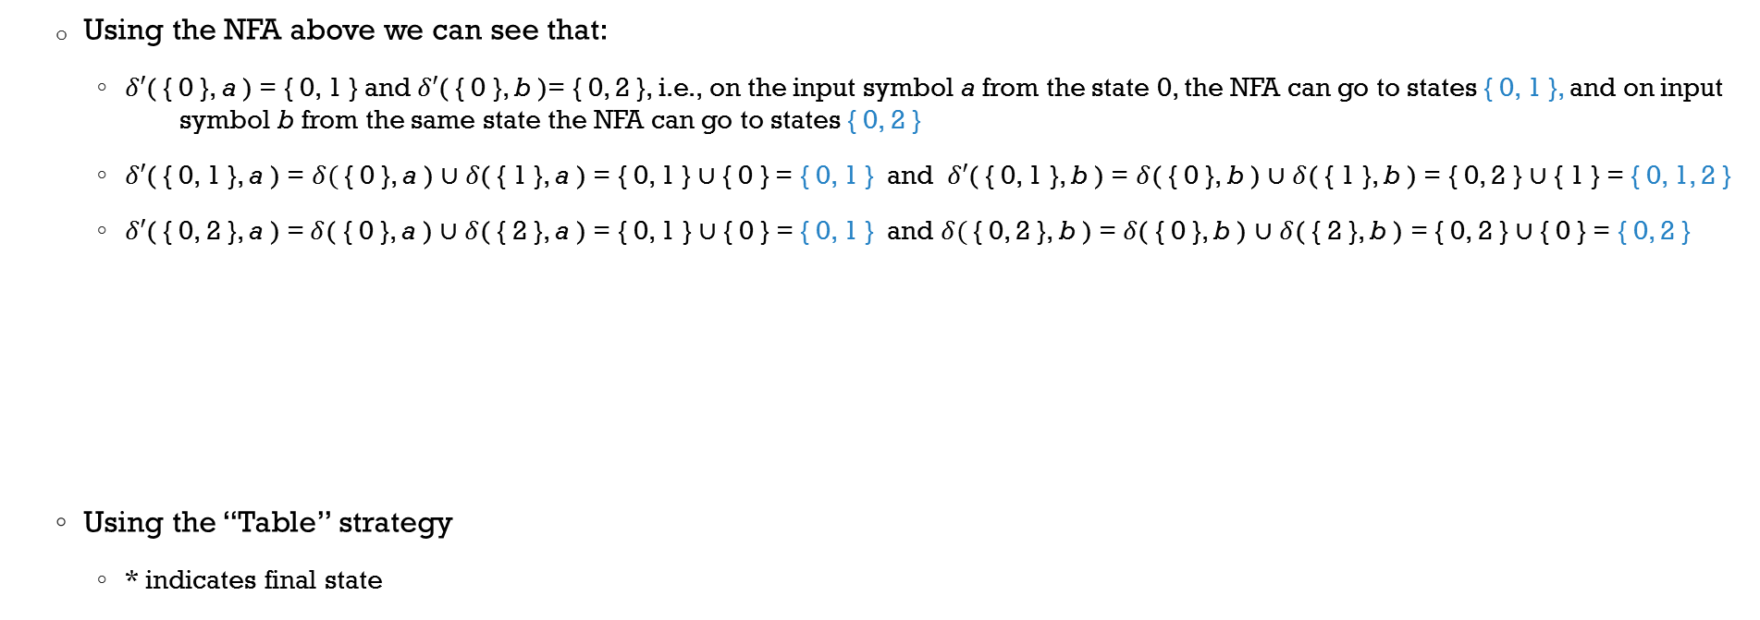
Example 1 - NFA to DFA
a, b
b
b
a
2
0
1
a, b
a
Using the NFA above we can see that:
$δ′$( { 0 }, a ) = { 0, 1 } and $δ′$( { 0 }, b )= { 0, 2 }, i.e., on the input symbol a from the state 0, the NFA can go to states { 0, 1 }, and on input symbol b from the same state the NFA can go to states { 0, 2 }
$δ′$( { 0, 1 }, a ) = $δ(${ 0 }, a ) ∪$δ$( { 1 }, a ) = { 0, 1 } ∪ { 0 } = { 0, 1 } and $δ′$( { 0, 1 }, b ) = $δ$( { 0 }, b ) ∪ $δ$( { 1 }, b ) = { 0, 2 } ∪ { 1 } = { 0, 1, 2 }
$δ′$( { 0, 2 }, a ) =$δ$( { 0 }, a ) ∪ $δ$( { 2 }, a ) = { 0, 1 } ∪ { 0 } = { 0, 1 } and $δ(${ 0, 2 }, b ) =$δ$( { 0 }, b ) ∪ $δ$( { 2 }, b ) = { 0, 2 } ∪ { 0 } = { 0, 2 }
Using the “Table” strategy
* indicates final state
States | a | b
→ 0 | { 0 , 1 } | { 0, 2 }
1 | { 0 } | { 1 }
2 * | { 0 } | { 0 }
→ { 0 } | { 0, 1 } | { 0, 2 }
{ 0, 1 } | { 0, 1 } | { 0, 1, 2 }
δ (NFA)
δ’ (DFA)
{ 0, 2 } *
{ 0, 1 }
{ 0, 2 }

Slide 53
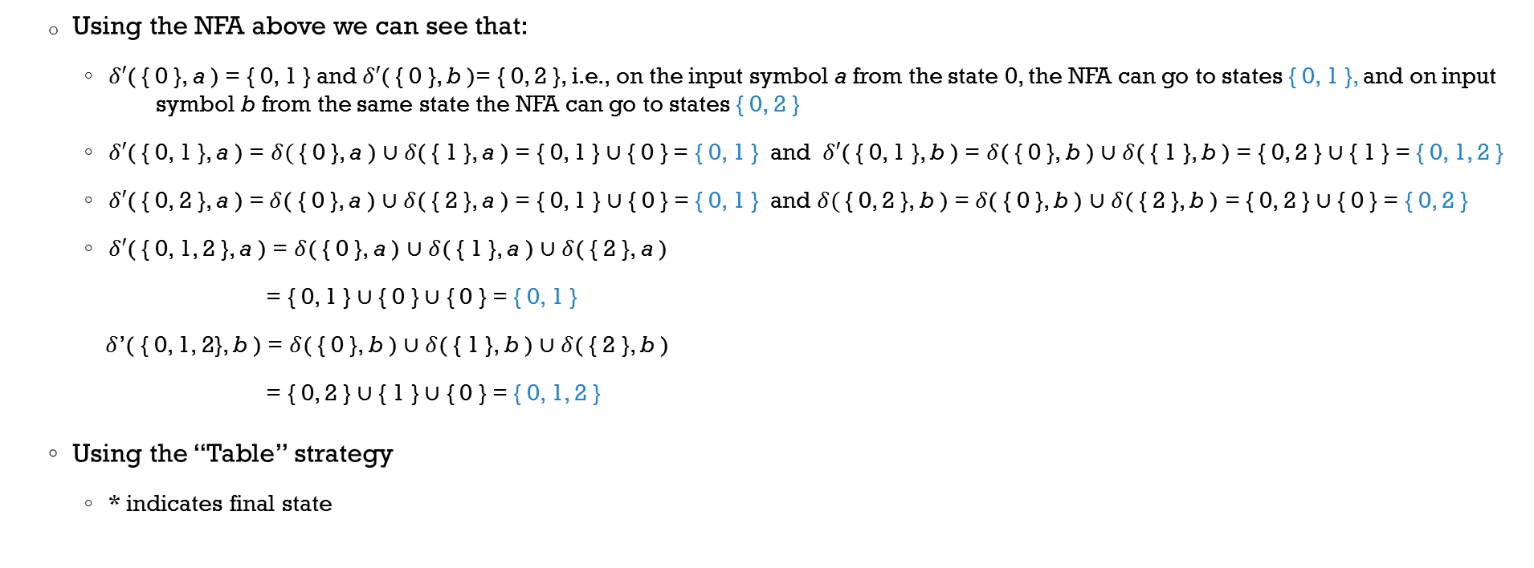
Example 1 - NFA to DFA
a, b
b
b
a
2
0
1
a, b
a
Using the NFA above we can see that:
$δ′$( { 0 }, a ) = { 0, 1 } and $δ′$( { 0 }, b )= { 0, 2 }, i.e., on the input symbol a from the state 0, the NFA can go to states { 0, 1 }, and on input symbol b from the same state the NFA can go to states { 0, 2 }
$δ′$( { 0, 1 }, a ) = $δ(${ 0 }, a ) ∪$δ$( { 1 }, a ) = { 0, 1 } ∪ { 0 } = { 0, 1 } and $δ′$( { 0, 1 }, b ) = $δ$( { 0 }, b ) ∪ $δ$( { 1 }, b ) = { 0, 2 } ∪ { 1 } = { 0, 1, 2 }
$δ′$( { 0, 2 }, a ) =$δ$( { 0 }, a ) ∪ $δ$( { 2 }, a ) = { 0, 1 } ∪ { 0 } = { 0, 1 } and $δ(${ 0, 2 }, b ) =$δ$( { 0 }, b ) ∪ $δ$( { 2 }, b ) = { 0, 2 } ∪ { 0 } = { 0, 2 }
$δ′$( { 0, 1, 2 }, a ) = $δ$( { 0 }, a ) ∪ $δ$( { 1 }, a ) ∪ $δ$( { 2 }, a )
= { 0, 1 } ∪ { 0 } ∪ { 0 } = { 0, 1 }
$δ$’( { 0, 1, 2}, b ) = $δ$( { 0 }, b ) ∪ $δ$( { 1 }, b ) ∪ $δ$( { 2 }, b )
= { 0, 2 } ∪ { 1 } ∪ { 0 } = { 0, 1, 2 }
Using the “Table” strategy
* indicates final state
States | a | b
→ 0 | { 0 , 1 } | { 0, 2 }
1 | { 0 } | { 1 }
2 * | { 0 } | { 0 }
→ { 0 } | { 0, 1 } | { 0, 2 }
{ 0, 1 } | { 0, 1 } | { 0, 1, 2 }
{ 0, 2 } * | { 0, 1 } | { 0, 2 }
δ (NFA)
δ’ (DFA)
{ 0, 1, 2 } *
{ 0, 1 }
{ 0, 1, 2 }

Slide 54
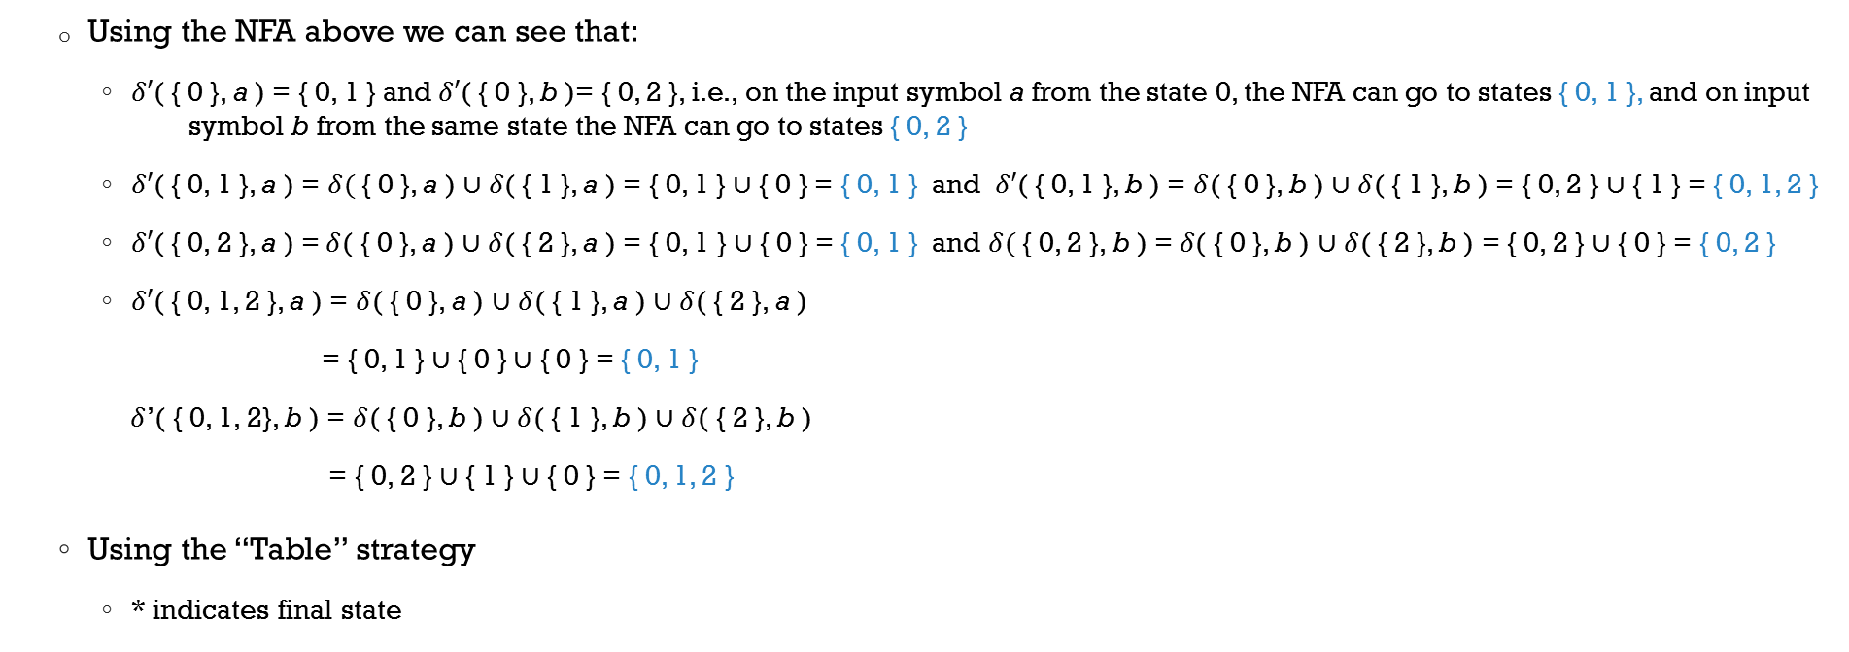
Example 1 - NFA to DFA
a
a, b
b
b
b
a
a
{0, 1}
b
a
{0, 1, 2}
2
0
1
{0}
a
a
b
a, b
b
{0, 2}
Using the NFA above we can see that:
$δ′$( { 0 }, a ) = { 0, 1 } and $δ′$( { 0 }, b )= { 0, 2 }, i.e., on the input symbol a from the state 0, the NFA can go to states { 0, 1 }, and on input symbol b from the same state the NFA can go to states { 0, 2 }
$δ′$( { 0, 1 }, a ) = $δ(${ 0 }, a ) ∪$δ$( { 1 }, a ) = { 0, 1 } ∪ { 0 } = { 0, 1 } and $δ′$( { 0, 1 }, b ) = $δ$( { 0 }, b ) ∪ $δ$( { 1 }, b ) = { 0, 2 } ∪ { 1 } = { 0, 1, 2 }
$δ′$( { 0, 2 }, a ) =$δ$( { 0 }, a ) ∪ $δ$( { 2 }, a ) = { 0, 1 } ∪ { 0 } = { 0, 1 } and $δ(${ 0, 2 }, b ) =$δ$( { 0 }, b ) ∪ $δ$( { 2 }, b ) = { 0, 2 } ∪ { 0 } = { 0, 2 }
$δ′$( { 0, 1, 2 }, a ) = $δ$( { 0 }, a ) ∪ $δ$( { 1 }, a ) ∪ $δ$( { 2 }, a )
= { 0, 1 } ∪ { 0 } ∪ { 0 } = { 0, 1 }
$δ$’( { 0, 1, 2}, b ) = $δ$( { 0 }, b ) ∪ $δ$( { 1 }, b ) ∪ $δ$( { 2 }, b )
= { 0, 2 } ∪ { 1 } ∪ { 0 } = { 0, 1, 2 }
Using the “Table” strategy
* indicates final state
States | a | b
→ 0 | { 0 , 1 } | { 0, 2 }
1 | { 0 } | { 1 }
2 * | { 0 } | { 0 }
→ { 0 } | { 0, 1 } | { 0, 2 }
{ 0, 1 } | { 0, 1 } | { 0, 1, 2 }
{ 0, 2 } * | { 0, 1 } | { 0, 2 }
{ 0, 1, 2 } * | { 0, 1 } | { 0, 1, 2 }
δ (NFA)
δ’ (DFA)

Slide 55
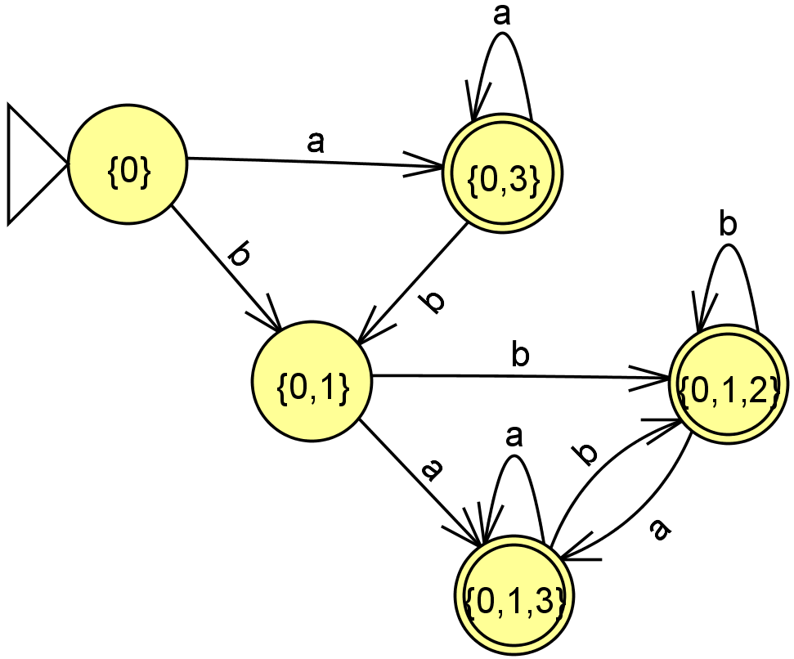
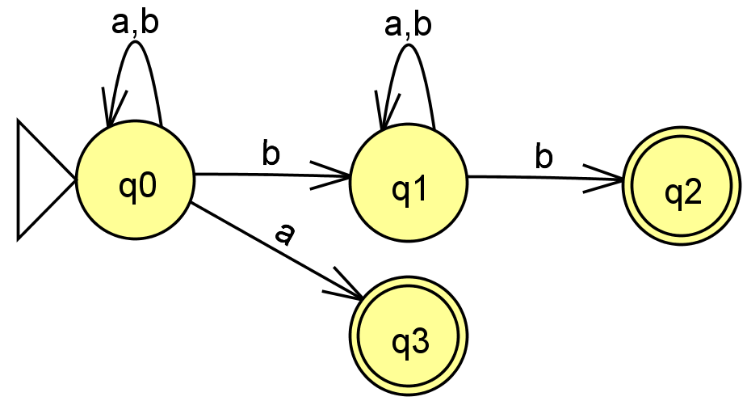
Example 2 - NFA to DFA
Nondeterministic FA
Deterministic FA

Slide 56
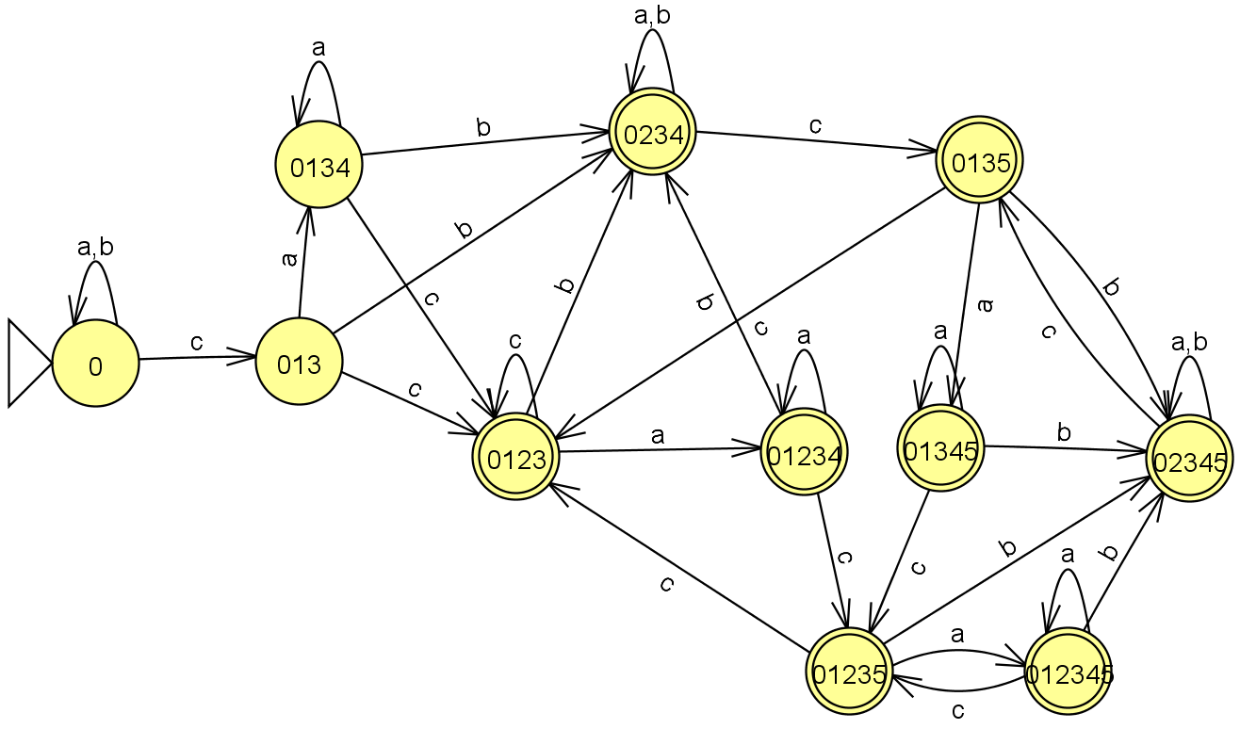
Example 3 - NFA to DFA
a
a, b
a, b, c
1
b, c
2
c
0
a,b
a, b
c
3
4
c
5
a, b
Nondeterministic FA
Deterministic FA

Slide 57
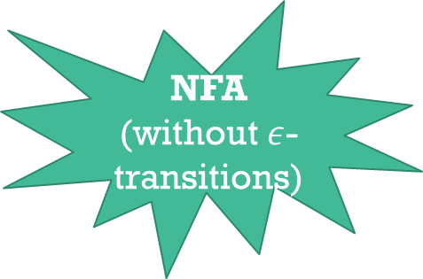
DFA
NFA
(without $ε$-transitions)
Construction of DM N = (Q’, ∑, δ’, q_{0’}, F’), a DFA, equivalent to NFA M = (Q, ∑, δ, q₀, F)
Initialize Q’ to {q₀}
Repeat
IF there is a node X ∈ Q’ and a symbol a ∈ ∑ with no arc leaving X labeled a, THEN
Let Y = ∪_{qi ∈ X} δ(q_{i}, a)
IF Y ∉ Q’, THEN set Q’ = Q’ ∪ { Y }
Add an arc from X to Y labeled a
ELSE done := true
UNTIL done
The set of accepting states of DM is F’ = { X ∈ Q’ | X contains q_{i} ∈ F }

Slide 58
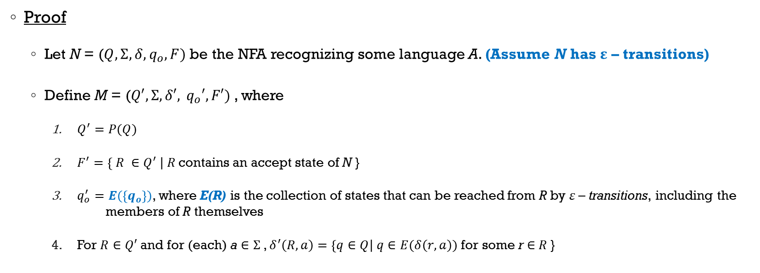
Equivalence of NFAs and DFAs (w/ ε-Transitions)
Proof
Let N = ($Q, Σ, δ, q_{o}, F)$be the NFA recognizing some language A. (Assume N has ε – transitions)
Define M = ($Q′, Σ, δ′, { q}_{o}′, F′)$, where
$Q^{′}=P(Q)$
$F^{′}=\left\{ R ∈Q^{′} \right| R$contains an accept state of N }
$q_{o}^{′}=E(\left\{q_{o}\right\})$, where E(R) is the collection of states that can be reached from R by ε – transitions, including the members of R themselves
For $R∈Q′$and for (each) a $∈Σ$, $δ^{′}\left(R,a\right)=\left\{q∈Q\right| q∈E(δ\left(r, a\right))$ for some r $∈$ $R$}

Slide 59
Equivalence of NFAs and DFAs
Construction of DM N = (Q’, ∑, δ’, q_{0’}, F’), a DFA, Equivalent to NFA M = (Q, ∑, δ, q₀, F)
Initialize Q’ to { E(q₀) }
Repeat
IF there is a node X ∈ Q’ and a symbol a ∈ ∑ with no arc leaving X labeled a, THEN
Let Y = ∪_{qi ∈ X} E(δ(q_{i}, a))
IF Y ∉ Q’, THEN set Q’ = Q’ ∪ { Y }
Add an arc from X to Y labeled a
ELSE done := true
Until done
The set of accepting states of DM is F’ = { X ∈ Q’ | X contains q_{i} ∈ F }
Remember:
E(q) = { states that can be reached from q by travelling along 0 or more ε – transitions }

Slide 60

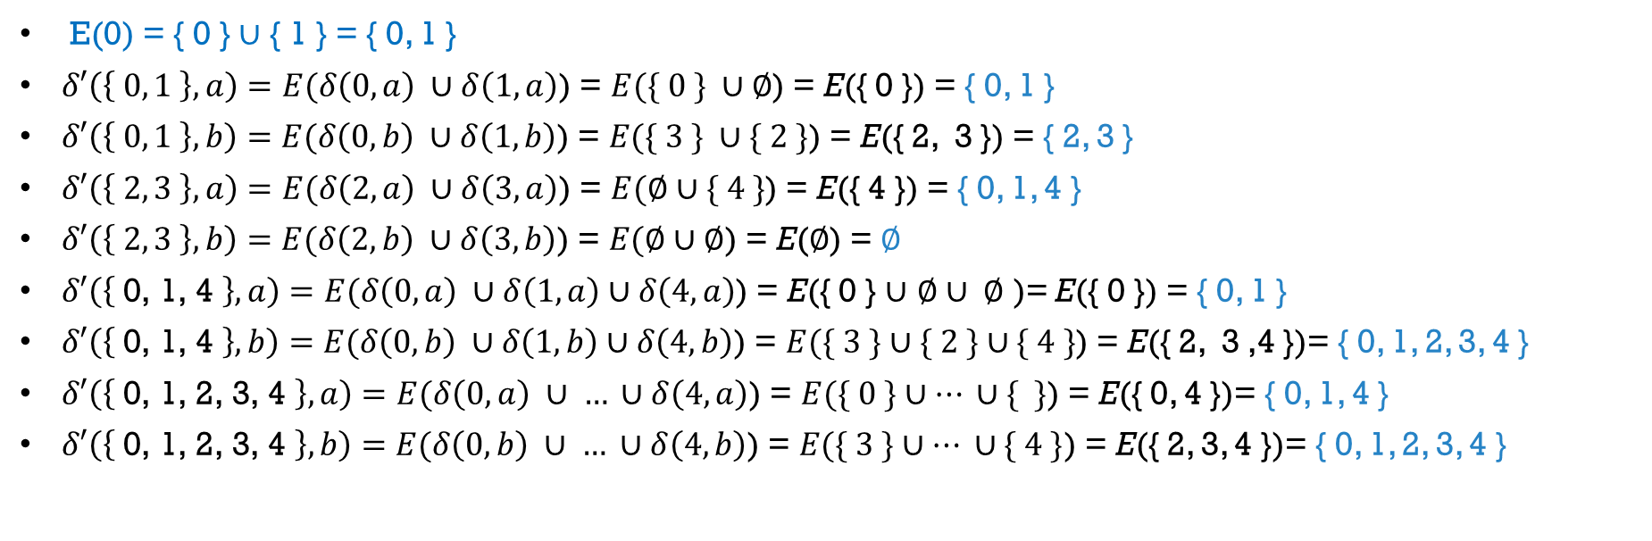
Example 4 - NFA to DFA
a
a
0
ε
1
b
2
{0, 1}
a
{0,1, 4}
b
b
ε
b
a
4
a
3
a
b
ε
b
$$∅$$
b
{2, 3}
{0,1, 2, 3, 4}
E(0) = { 0 } ∪ { 1 } = { 0, 1 }
$δ′\left(\left\{ 0, 1 \right\}, a\right)=E(δ\left(0, a\right) ∪δ\left(1, a\right)$) = $E(\{ 0 \} ∪∅$) = E({ 0 }) = { 0, 1 }
$δ′\left(\left\{ 0, 1 \right\}, b\right)=E(δ\left(0, b\right) ∪δ\left(1, b\right)$) = $E(\{ 3 \} ∪\{ 2 \}$) = E({ 2, 3 }) = { 2, 3 }
$δ′\left(\left\{ 2, 3 \right\}, a\right)=E(δ\left(2, a\right) ∪δ\left(3, a\right)$) = $E(∅∪\{ 4 \}$) = E({ 4 }) = { 0, 1, 4 }
$δ′\left(\left\{ 2, 3 \right\},b\right)=E(δ\left(2, b\right) ∪δ\left(3, b\right)$) = $E(∅∪∅$) = E($∅$) = $∅$
$δ′\left(\left\{ \text{0, 1, 4} \right\}, a\right)=E(δ\left(0, a\right) ∪δ\left(1, a\right)∪δ\left(4, a\right)$) = E({ 0 } $∪$ $∅$ $∪ ∅$ )= E({ 0 }) = { 0, 1 }
$δ′\left(\left\{ \text{0, 1, 4} \right\}, b\right)=E(δ\left(0, b\right) ∪δ\left(1, b\right)∪δ\left(4, b\right)$) = $E(\{ 3 \}∪\{ 2 \}∪\{ 4 \}$) = E({ 2, 3 ,4 })= { 0, 1, 2, 3, 4 }
$δ′\left(\left\{ \text{0, 1, }\text{2, 3, }\text{4 }\right\}, a\right)=E(δ\left(0, a\right) ∪ … ∪δ\left(4, a\right)$) = $E(\{ 0 \}∪… ∪\{ \}$) = E({ 0, 4 })= { 0, 1, 4 }
$δ′\left(\left\{ \text{0, 1, 2, 3, 4 }\right\}, b\right)=E(δ\left(0, b\right) ∪ … ∪δ\left(4, b\right)$) = $E(\{ 3 \}∪… ∪\{ 4 \}$) = E({ 2, 3, 4 })= { 0, 1, 2, 3, 4 }

Slide 61
Example 5 - NFA (with ε–transitions) to DFA
Consider the following NFA
a
b
 | a | b | c | E(q)
q₀
q₁
q₂
q₀
a
q₁
{ q₀,q₁,q₂ } { } { } { q₀ }
Transitions (δ) from NFA
{ } { q₁ } { } { q₁ }
a
q₂
ε
{ } { } { q₂ } { q₁, q₂ }
c
a
 | a | b | c
a
{q_{0,} q_{1,} q₂}
b
{ q₀ }
{ q₀,q₁,q₂ } | { } | { }
{q₀}
Transitions (δ’) for DFA
{ q₁, q₂ }
b
{ q₀,q₁,q₂ }*
{ q₀,q₁,q₂ }
{ q₁ }
c
{q₁}
{ q₁ }*
{ } | { q₁ } | { }
{q_{1,} q₂}
b
{ q₁,q₂ }*
{ }
{ q₁ }
{ q₁, q₂ }
c

Slide 62
Equivalence of NFAs and DFAs
Theorem 1.39 state that every NFA can be converted into an equivalent DFA
Corollary
A language is regular if an only if some nondeterministic finite automaton recognizes it

Slide 63
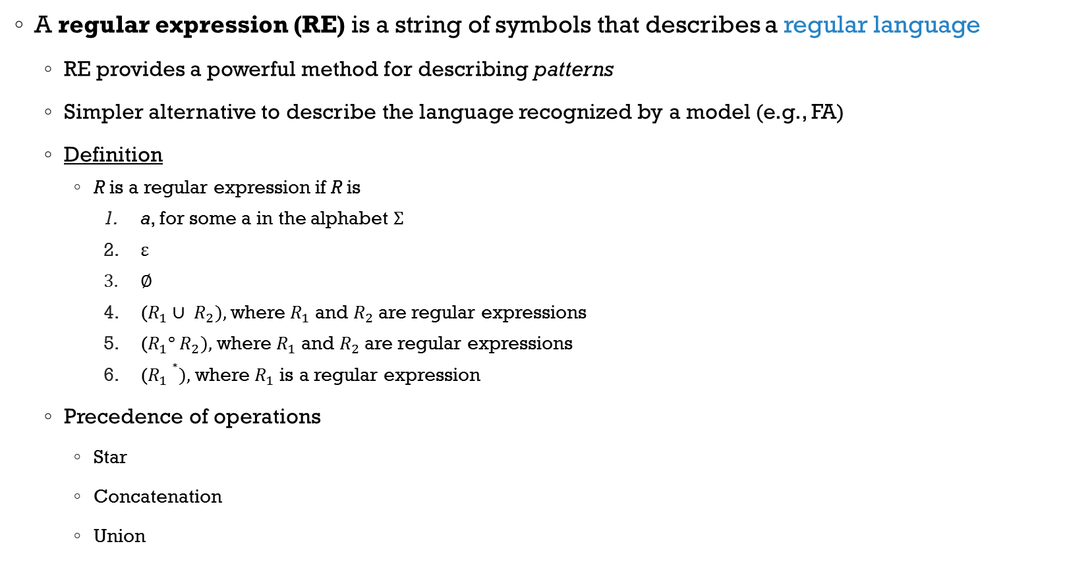
Regular Expressions
A regular expression (RE) is a string of symbols that describes a regular language
RE provides a powerful method for describing patterns
Simpler alternative to describe the language recognized by a model (e.g., FA)
Definition
R is a regular expression if R is
a, for some a in the alphabet $Σ$
ε
$∅$
($R_{1}∪ R_{2}),$ where $R_{1}$ and $R_{2}$ are regular expressions
($R_{1}° R_{2}),$ where $R_{1}$ and $R_{2}$ are regular expressions
($R_{1}∗),$ where $R_{1}$ is a regular expression
Precedence of operations
Star
Concatenation
Union

Slide 64
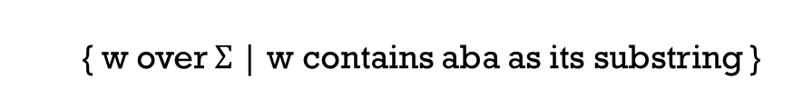
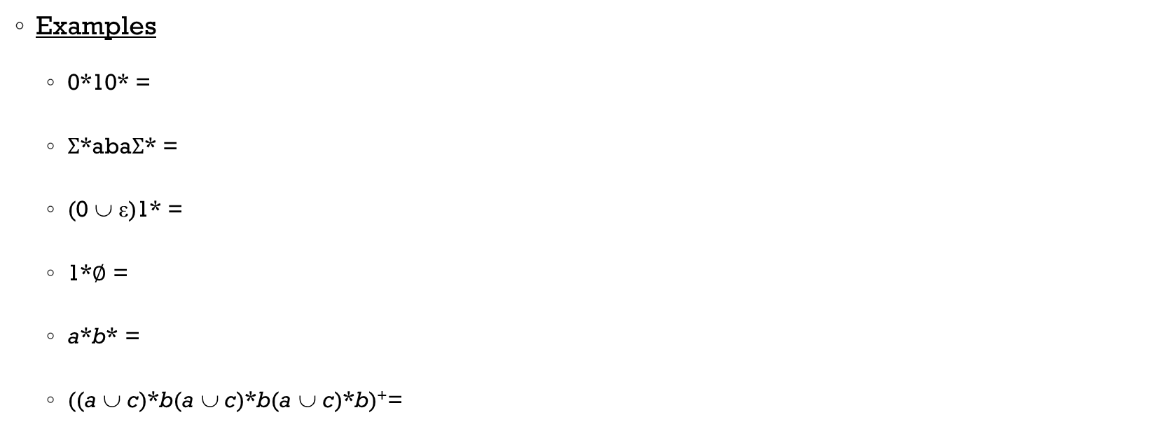
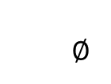
Regular Expressions
Examples
0*10* =
$Σ$*aba$Σ$* =
(0 ∪ ε)1* =
1*$∅$ =
a*b* =
((a ∪ c)*b(a ∪ c)*b(a ∪ c)*b)⁺=
{ w over { 0, 1 }| w contains a single 1 }
{ w over $Σ$| w contains aba as its substring }
01* ∪ 1*
$$∅$$
any string without substring ba
strings where the number of b’s is a multiple of 3 & end w/ a ‘b’

Slide 65
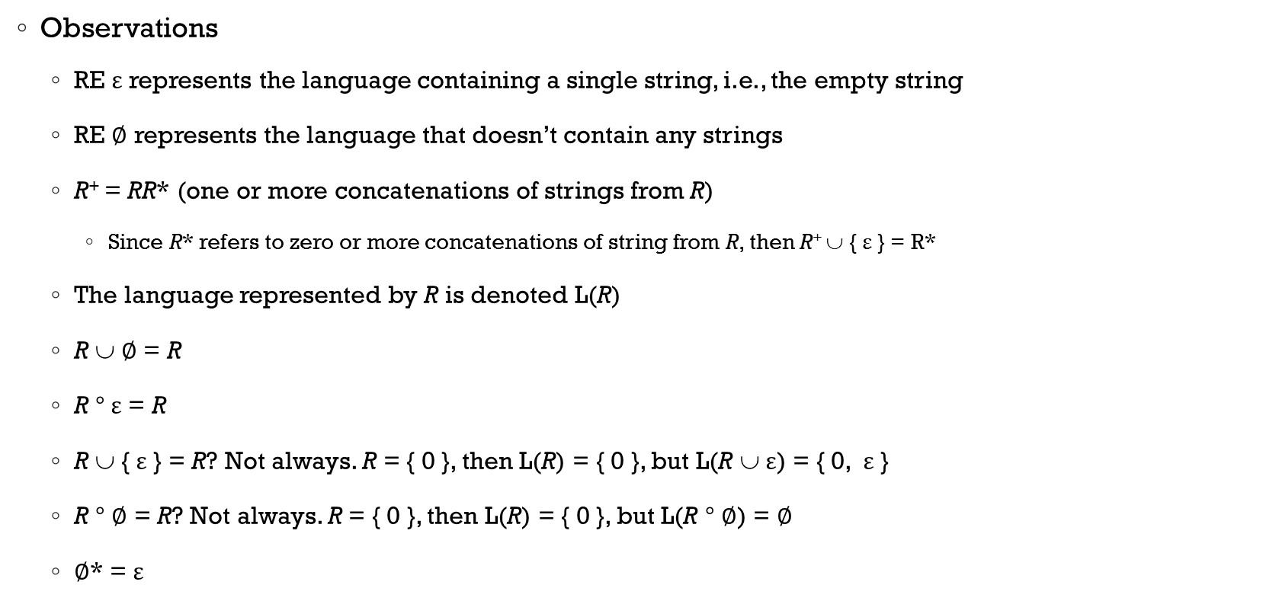
Regular Expressions
Observations
RE ε represents the language containing a single string, i.e., the empty string
RE $∅$ represents the language that doesn’t contain any strings
R⁺ = RR* (one or more concatenations of strings from R)
Since R* refers to zero or more concatenations of string from R, then R⁺ ∪ { ε } = R*
The language represented by R is denoted L(R)
R ∪ $∅$ = R
R $°$ε = R
R ∪ { ε } = R? Not always. R = { 0 }, then L(R) = { 0 }, but L(R ∪ ε) = { 0, ε }
R $°$ $∅$ = R? Not always. R = { 0 }, then L(R) = { 0 }, but L(R $°$ $∅$) = $∅$
$∅$* = ε

Slide 66
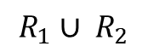
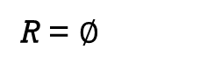
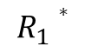
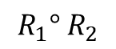
Equivalence with FAs
Theorem
A language is regular if and only if some regular expression describes it
Lemma
If a language is described by a regular expression, then it is regular
Proof idea:
We have a RE R describing a language A and we show how to convert R into a NFA that recognizes A. By corollary 1.40, if NFA recognizes A, then A is regular
Proof: by construction, on each of the six cases in the formal definition of RE
a
$$R_{1}∪ R_{2}$$
$$R_{1}° R_{2}$$
Illustrated on NFAs on slide 43
R = a
R = ε
R = $∅$
$$R_{1}∗$$

Slide 67
Equivalence with FAs
Example
Show that (ab ∪ a)* represents a regular language
Show that (a ∪ b)*aba represents a regular language
a
b
a
b
ε
ε
ε
a
ε
a

Slide 68
NFA to RE
Lemma 1.60
If a language is regular, then it is described by a regular expression
Proof idea: Describe the procedure for converting FAs into equivalent regular expressions
Generalized Nondeterministic Finite Automata (GNFA)
Very similar to an NFA, except that a label of a GNFA can be a regular expression
Can read blocks of symbols from the input where symbols are strings of a regular expression
Example
GNFA accepts all strings over { a, b } with substring aba or aa
a ∪ b
a ∪ b
aba ∪ aa
(a ∪ b)*(aba ∪ aa)(a ∪ b)*

Slide 69
GNFA
Basic idea
Convert FA into GNFA which satisfies the following conditions
The start state has only outgoing transitions, but does not have any incoming/loopback transitions
There is only a single ﬁnal state, which has only incoming transitions, but does not have any outgoing/loopback transitions
Eliminate the states of the GNFA one by one (except start and ﬁnal states), and update the transitions accordingly, so that the new GNFA recognizes the same language
From a state to any other state there should be at most one transition
When only the start state and the ﬁnal state are left, the transition from the start state to the ﬁnal state is an equivalent regular expression

Slide 70
GNFA – Example 1
a
a, b
b
1
2
a
a, b
b
1
2
a, b
ε
ε
S
F
2
a*b
ε
S
F
a*b (a ∪ b)*
S
F

Slide 71
GNFA – Example 2
General Rule for State Elimination
Consider three states q_{i}, q_{j}, and q_{del} where the latter is the state we want to eliminate & let the transitions between those three states be as follows
δ(q_{i,} R₁) = q_{del}
δ(q_{del,} R₂) = q_{del}
δ(q_{del,} R₃) = q_{j}
δ(q_{i,} R₄) = q_{j}, where R_{i} (1 ≤ i ≤ 4) is some regular expression/single alphabetical symbol describing that transition
Example (b)
Example (a)
Original RE from q_{i} to q_{j}
RE resulting from removing q_{del}

Slide 72
GNFA – Example 3
What is the regular expressions of the language recognized by the following FA?
Add a new start/final state
GNFA (with a single start and single final state)

Slide 73
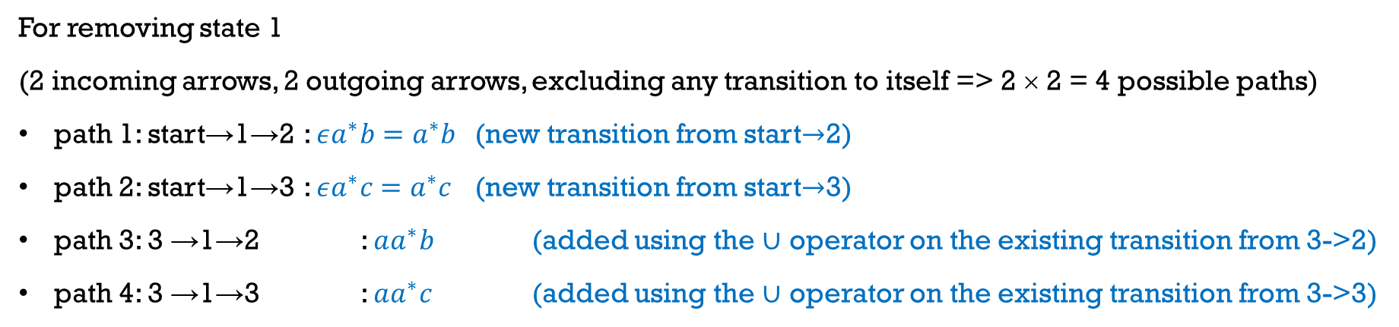
GNFA – Example 3 (Continued)
For removing state 1
(2 incoming arrows, 2 outgoing arrows, excluding any transition to itself => 2 × 2 = 4 possible paths)
path 1: start→1→2 : $εa^{∗}b=a^{∗}b$ (new transition from start$→$2)
path 2: start→1→3 : $εa^{∗}c=a^{∗}c$ (new transition from start$→$3)
path 3: 3 →1→2 : $aa^{∗}b$ (added using the $∪$ operator on the existing transition from 3->2)
path 4: 3 →1→3 : $aa^{∗}c$ (added using the $∪$ operator on the existing transition from 3->3)

Slide 74
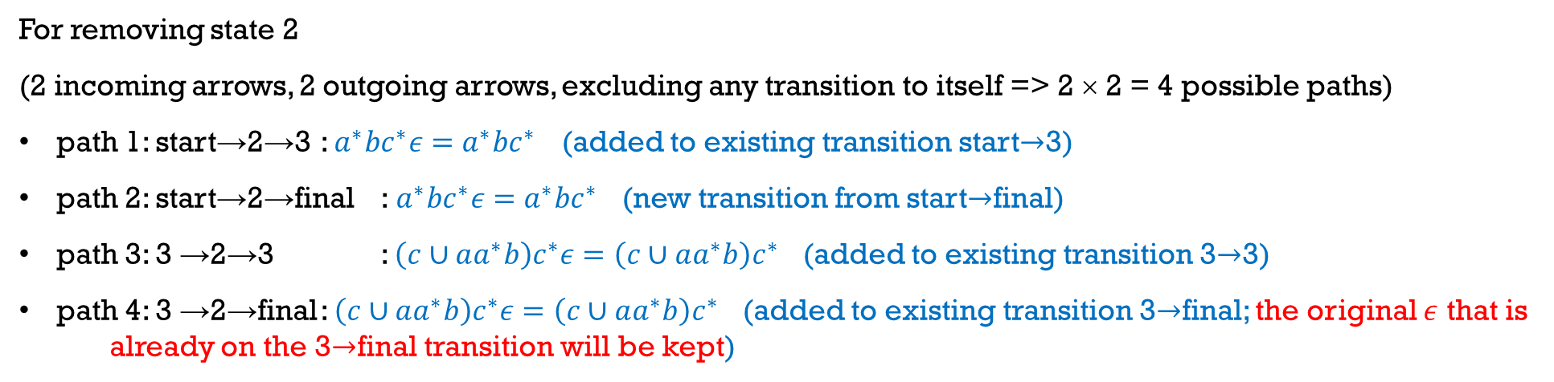
GNFA – Example 3 (Continued)
For removing state 2
(2 incoming arrows, 2 outgoing arrows, excluding any transition to itself => 2 × 2 = 4 possible paths)
path 1: start→2→3 : $a^{∗}bc^{∗}ε=a^{∗}bc^{∗}$ (added to existing transition start$→$3)
path 2: start→2→final :$a^{∗}bc^{∗}ε=a^{∗}bc^{∗}$ (new transition from start$→$final)
path 3: 3 →2→3 : $\left(c∪aa^{∗}b\right)c^{∗}ε=\left(c∪aa^{∗}b\right)c^{∗}$ (added to existing transition 3$→$3)
path 4: 3 →2→final : $\left(c∪aa^{∗}b\right)c^{∗}ε=\left(c∪aa^{∗}b\right)c^{∗}$ (added to existing transition 3$→$final; the original $ε$ that is already on the 3$→$final transition will be kept)

Slide 75
GNFA – Example 3 (Continued)
For removing 3
path 2: start → 3 → final, and adding
path 1: start → final

Slide 76
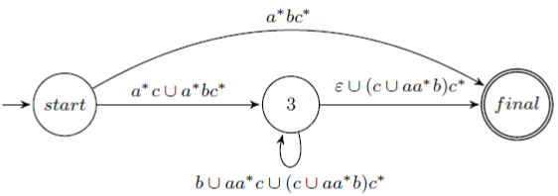
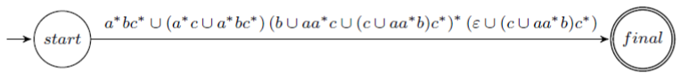
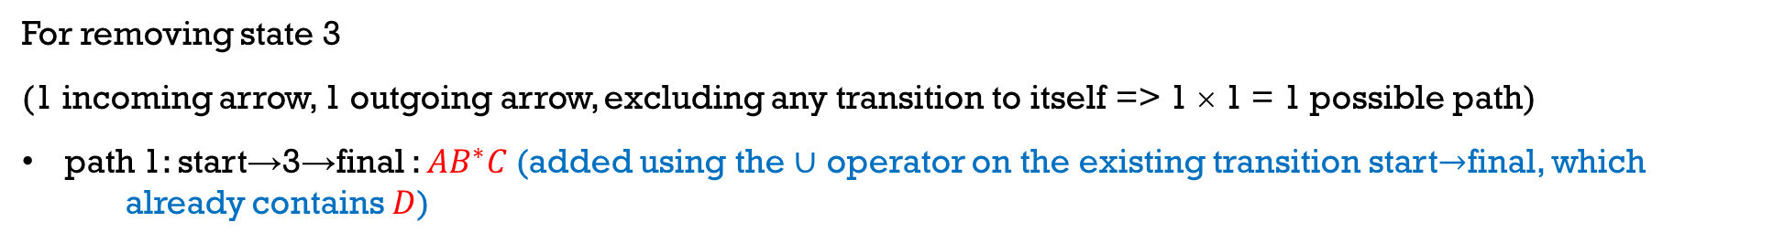
GNFA – Example 3 (Continued)
D
A
C
B
Remove 3
D
A
B
C
For removing state 3
(1 incoming arrow, 1 outgoing arrow, excluding any transition to itself => 1 × 1 = 1 possible path)
path 1: start→3→final : ${AB}^{∗}C$(added using the $∪$ operator on the existing transition start$→$final, which already contains $D$)

Slide 77
So Far…
Deterministic FA
Accepts/ Recognizes
Regular Languages
Conversion algorithm
Nondeterministic FA
How do we verify a language is not regular?
Describes
Conversion algorithm from GNFA
PUMPING LEMMA
Regular Expressions

Slide 78
Non-Regular Languages
Limitation for FA:
Can’t deal with languages that require “remembering” an infinite number of “matchings”, on a finite number of states
Example
The language {a^{i}b^{i} | 0 ≤ i ≤ n} is regular, but the language {a^{i} b^{i} | i ≥ 0} is not
FA cannot be extended to accept { a^{i} b^{i} | i ≥ 0 }, since an infinite number of states are needed
a₀
a
a₁
a
a
. . .
a
a_{n-1}
a
a_{n}
>
a₂
b
b
b
b
b
b
. . .
b
b_{n-2}
b
b_{n-1}
b₀
b₁

Slide 79
Pumping Lemma for Regular Languages
Pumping Lemma
Technique for proving nonregularity
The idea is to show that if a language doesn’t have a known property of regular languages, then it is nonregular
The property states that string in the language can be “pumped” if they are of a certain length
Basically, if a section of a string can be repeated and the resulting string remains in the language, then we are dealing with a regular language

